Slide 1
Buddhist Architecture
Buddhism developed from the teachings of Gautama, the Buddha
According to him, the way of salvation was NIRVANA (Mind & Soul)
He organised his followers in the Sangha
During Kaniska Reign There arouse a division across : Hinayana and Mahayana sect
According to Hinayana sect, the original teachings and worships were to be followed
while the Mahayana sect worships Buddha as God and the Buddha was represented in human form.

Slide 2
Buddhist Architecture
Hinayana and Mahayana sect
Ahokan Pillars
Chaitya halls
Viharas
Stupas

Slide 3
Ahokan Pillars

Slide 4
Monolithic Pillar
Has great artistic values.
Boldly designed ,finely proportioned and conceptually well balanced.
Free standing pillars, not part of an architectural composition.
Aesthetic properties concentrated on capitals and superstructures.
The pillars are on average about 40-50 feet high and weighed up to around 50 tons each.
Both pieces (shaft & Supersturucture) joined by a copper bolt accurately fitted into the tenon made for it without use of cement.

Slide 5
Details (monolithic Pillar)
Each pillar has 2 parts – Shaft , capital
Shaft- circular piece of stone tapering towards upperside (40-50 ft) long.
Capital – Placed on the top of the tapering shaft.
Capital further is in three parts –Inverted lotus or bell
Base pedestal
Animal and animal with Dharma-chakra
Red sandstone for construction.- as they have magnificicent shape, proportions,coronation and surface finish.

Slide 6
Fluting and radial pattern seem under complete control and coordination with the top circle of the capital.
• The column is persepolitan and is octagonal with bell shaped capital.
The capital consists of a canopy representing an inverted bell shaped lotus flower, a short cylindrical abacus with four 24-spoked dharma
wheels with fur animals(an elephant, a bull, a horse , a lion).

Slide 7
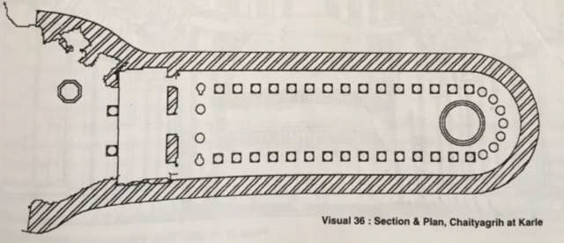
Chaitya halls
Plan : Chaitya hall at Karli

Slide 8
Chaitya – from Sanskrit term - means pyre or Sacred spot
Rock -cut Buddhist architecture ---Chaitya hall (Prayer hall)
Though it was great in size, it had function limitation during unfavorable weather.
The solution Chaitya hall ( enclosed space) with a miniature stupa at one endSacred spot
Temple as well as assembly hall relating Buddhism
•Vaulted hall with non – structural colonnade
Rectangular hall with apsidal end with chaitya)

Slide 9
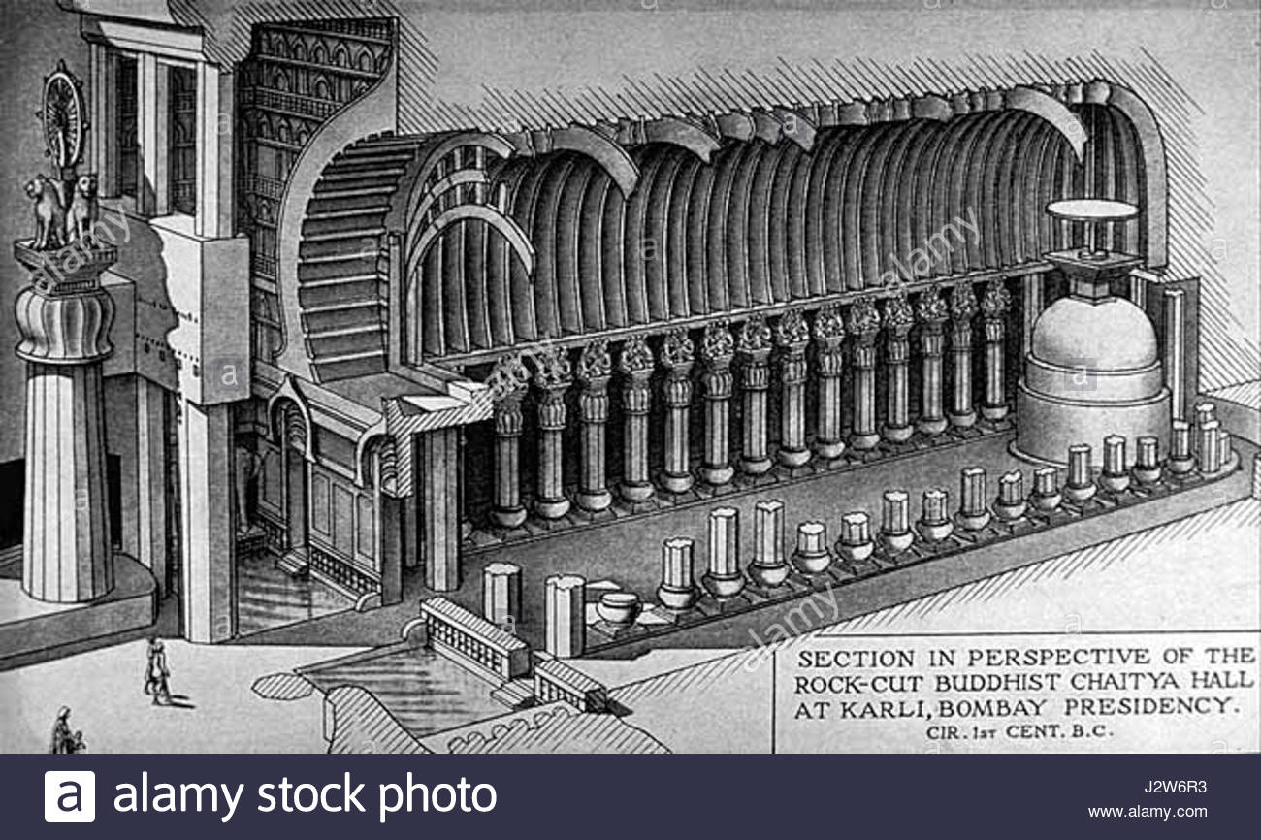
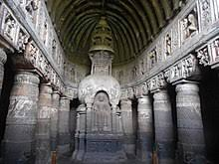

Slide 10
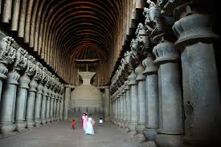
Double row of columns divide whole area into nave , ( used as congregational space) in the centre and double aisles (circumbulation space) all around the colonnade and stupa
Entry through rectangular opening with chaitya window or sun window (derived from period hut)
Stupa has been carved out of living rock
Examples:
Chaitya cave at Bhaja, Karle, Ajanta
Chaitya hall at Kondane, Ellora

Slide 11
Chaitya hall at karle
Gigantic hall(14mx46m) with 13.7m high vaulted roof , is very unique and extra ordinary than other chaitya hall
• A large platform built at the sloping hill side leading to the magnificent cave
• Entrance is guided by 2 enormous 15.2 m high free standing stone column crowned with lion
• The next important part is a trantitional vestibule with double height.
The walls are magnificiently carved with recessed sun window set in horse shoe archway
The hall contains 2 rows of column forming nave at the centre and aisles all around which was used for circumbulation

Slide 12
Interior of chaitya,Karle

Slide 13
Each column is 7.32 m high with 1.22m dia
The shaft is octagonal with vase shaped base
Capital is bell shaped and sculptured
The stupa at the end is carved with railing and has inverted pyramid type finial
The marvelous things of the cave are magical quality space, light and sculpture along with their relationship

Slide 14
Vihara •
These are the residential places of the buddhist priests.
They consist of a main-hall entered by a door-way.
They also contain the assembly hall, dining chambers.
From the halls deep into the rocks, cells are provided for meditation.
The shrines contains beautiful figures of Buddha and the walls of the antechamber depict
the stories based on Buddha's life and fine frescoes as in case of Ajanta.
Some great structural viharas were about 60m high covered with glazed tiles.
Pillars were richly chiseled in the form of dragons.
Beams were painted in red and rafter with all colors of rainbow.
Viharas were literally the pleasure gardens of monastic precincts.
Some of the important Buddhist viharas are those at Ajanta, Ellora. Nasik, Karle, Kanheri, Bagh and Badami.

Slide 15
The site for structural viharas has to fulfill the two conditions:
a.Proximity to some village
b.Enough seclusion to ensure the proper atmosphere for
medtation.
According to Pali texts, the viharas include:
1.Living rooms
2.Private dwellings (parivenas)
3.Mandapas
4.Service corridors (upatthama salas)
5.Aggi salas (Halls with the fire places)
6.Kothaks (porches)
7.Chankamas (proomenades)
8.Store houses
9.Passages attached to bathrooms
10.Wells
11.Sheds attached to walls

Slide 17
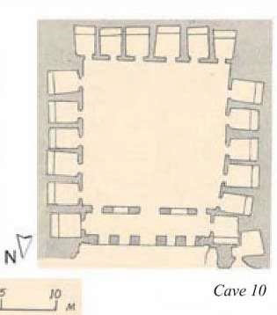

Slide 18
Stupa : Evolution
The first Buddhist 'shrines' were mere piles of stone or rubble containing relics of the Buddha.
Over time it became necessary to 'upgrade' these structures, in conformity with Buddhism's rising status.
For structural reasons it was necessary to have a wide base, tapering towards the top.
The form chosen for the Buddhist Stupa was that of a sphere – as much for the shape's metaphysical associations as for the fact that it was an antipode to the square/rectangular form of Hindu temples.

Slide 19
The Stupa was the most sacred symbol of the Buddha.
These were tumuli of brick with a great spiritual significance.
Normally consisted of: Masonry hemisphere 70’ 0” dia.,35’0” high.
Solid of large unburnt bricks each around 16”x10”x3”.
In the center of this mound or Anda was a small space for a receptacle containing the relic of the Buddha.
On the summit was an honorific umbrella – wooden parasol Chattrayashti.
The brickwork of the stupa was finished of with a thick layer of plaster in which recesses were left at intervals for small lamps to be lit during festivals
A certain amount of colour and gilding was also applied, furnished with festoons of flowers and drapery with banners and flags.

Slide 20
Sanchi Stupa
Reconstructed around 150 BC
Enlarged to nearly twice the size retaining the original Brick tumulus of Asokan period
The Stupa was hence encased within an envelope – Achchaday
The structure was hence 120’0” dia. 54’0” high
A terrace- Medhi was added 16’0” from the ground providing a separate lower and upper ambulatory
Access to the medhi was on the S side by a double stairway- Sopana

Slide 21
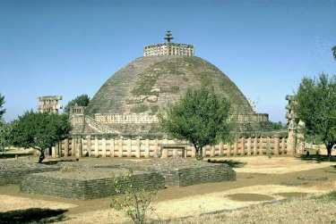

Slide 22
After the end of the Mauryan dynasty in 185 BC we had the Sungas taking over and ruling till 70 BC in the N and W regions
The Sungas were tolerant to the Buddhists
During the Sungan period we had the main change being improvement of the stupa into a more dignified architectural structure
Replacement of the impermanent materials with permanent materials such as stone
This is understood by analysing the alterations made to surviving egs.,
the chief one being Sanchi

Slide 25
'Great Stupa' at Sanchi
The is the oldest stone structure in India and was originally commissioned by the emperor Ashoka the Great in the 3rd century BCE.
Its nucleus was a simple hemispherical brick structure built over the relics of the Buddha.
It was crowned by the chatra, a parasol-like structure symbolizing high rank, which was intended to honour and shelter the relics.
It has four profusely carved ornamental gateways and a balustrade encircling the whole structure.

Slide 26
DOME- is a solid brick-work 32.32m in diameter and 12.8m high.
The dome has a slight ‘crushed’ profile at top and was surmounted by HARMIKA with a central triple UMBRELLA.
The facing of the dome consists of dry masonry composed of hammer dressed stones laid in even courses.
The terrace 4.87m high from ground was added thus creating a separate and upper AMBULATORY passage 1.8m wide access to which was provided by a double staircase with high BALUSTRADE, on the south side

Slide 27
There are four gateways known as ‘TORANAS’ at the cardinal points to the compass and are slightly staggered from the railing enclosing stupa.
The ambulatory or pradakshina path is fenced by railing 3.35m high all around the stupa.
Outside the railing there once stood the famous ashoka pillar, the fragments of which are noticed now to the right of southern torana

Slide 28
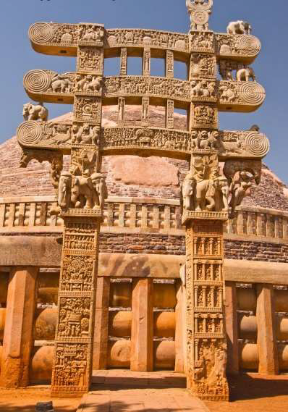
Torans

Slide 29
Torana
Toranas, the entrance to the ambulatory were accepted as the traditional type of ceremonial potals and excel the array of architectural embellishment.
Torana consists of two square uprite columns with capital of lion or elephant heads denoting strength.
These columns support three separate horizontal panels between each of which is a row of ornamental balusters.
These panels are supported by atlantean figures, a group of dwarfs, lions and elephant.
The total height of this erection is somewhat 10.36m with a width of 3m s

Slide 30
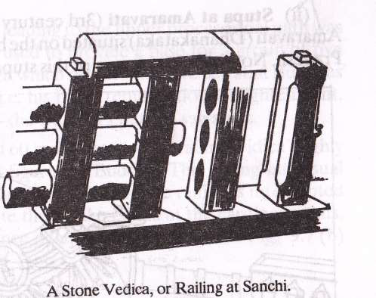
RAILING OR VEDICA
The vedica or railing consists of upright octagonal plan 45cm in diameter spaced at 60 to 90cm from each other and connected by three lens shaped horizontals called ‘suchi’ or needles 60cm deep being threaded through the holes of the upright.
• The top horizontal bar is provided with coping to drain out rain water.

Slide 31
Asokan School of Architecture
The significance of this school lies in the fact that it marks the beginning of an era when India , through Buddhist thought was in a position to dictate the rest of Asia, its religion, its symbolism and its art.
The principal contributions made by this school to art and
architecture were :
Series of edicts inscribed on rocks
Number of tumuli or stupas
• Monolithic pillars
• Group of rock cut chambers

